Slide 1
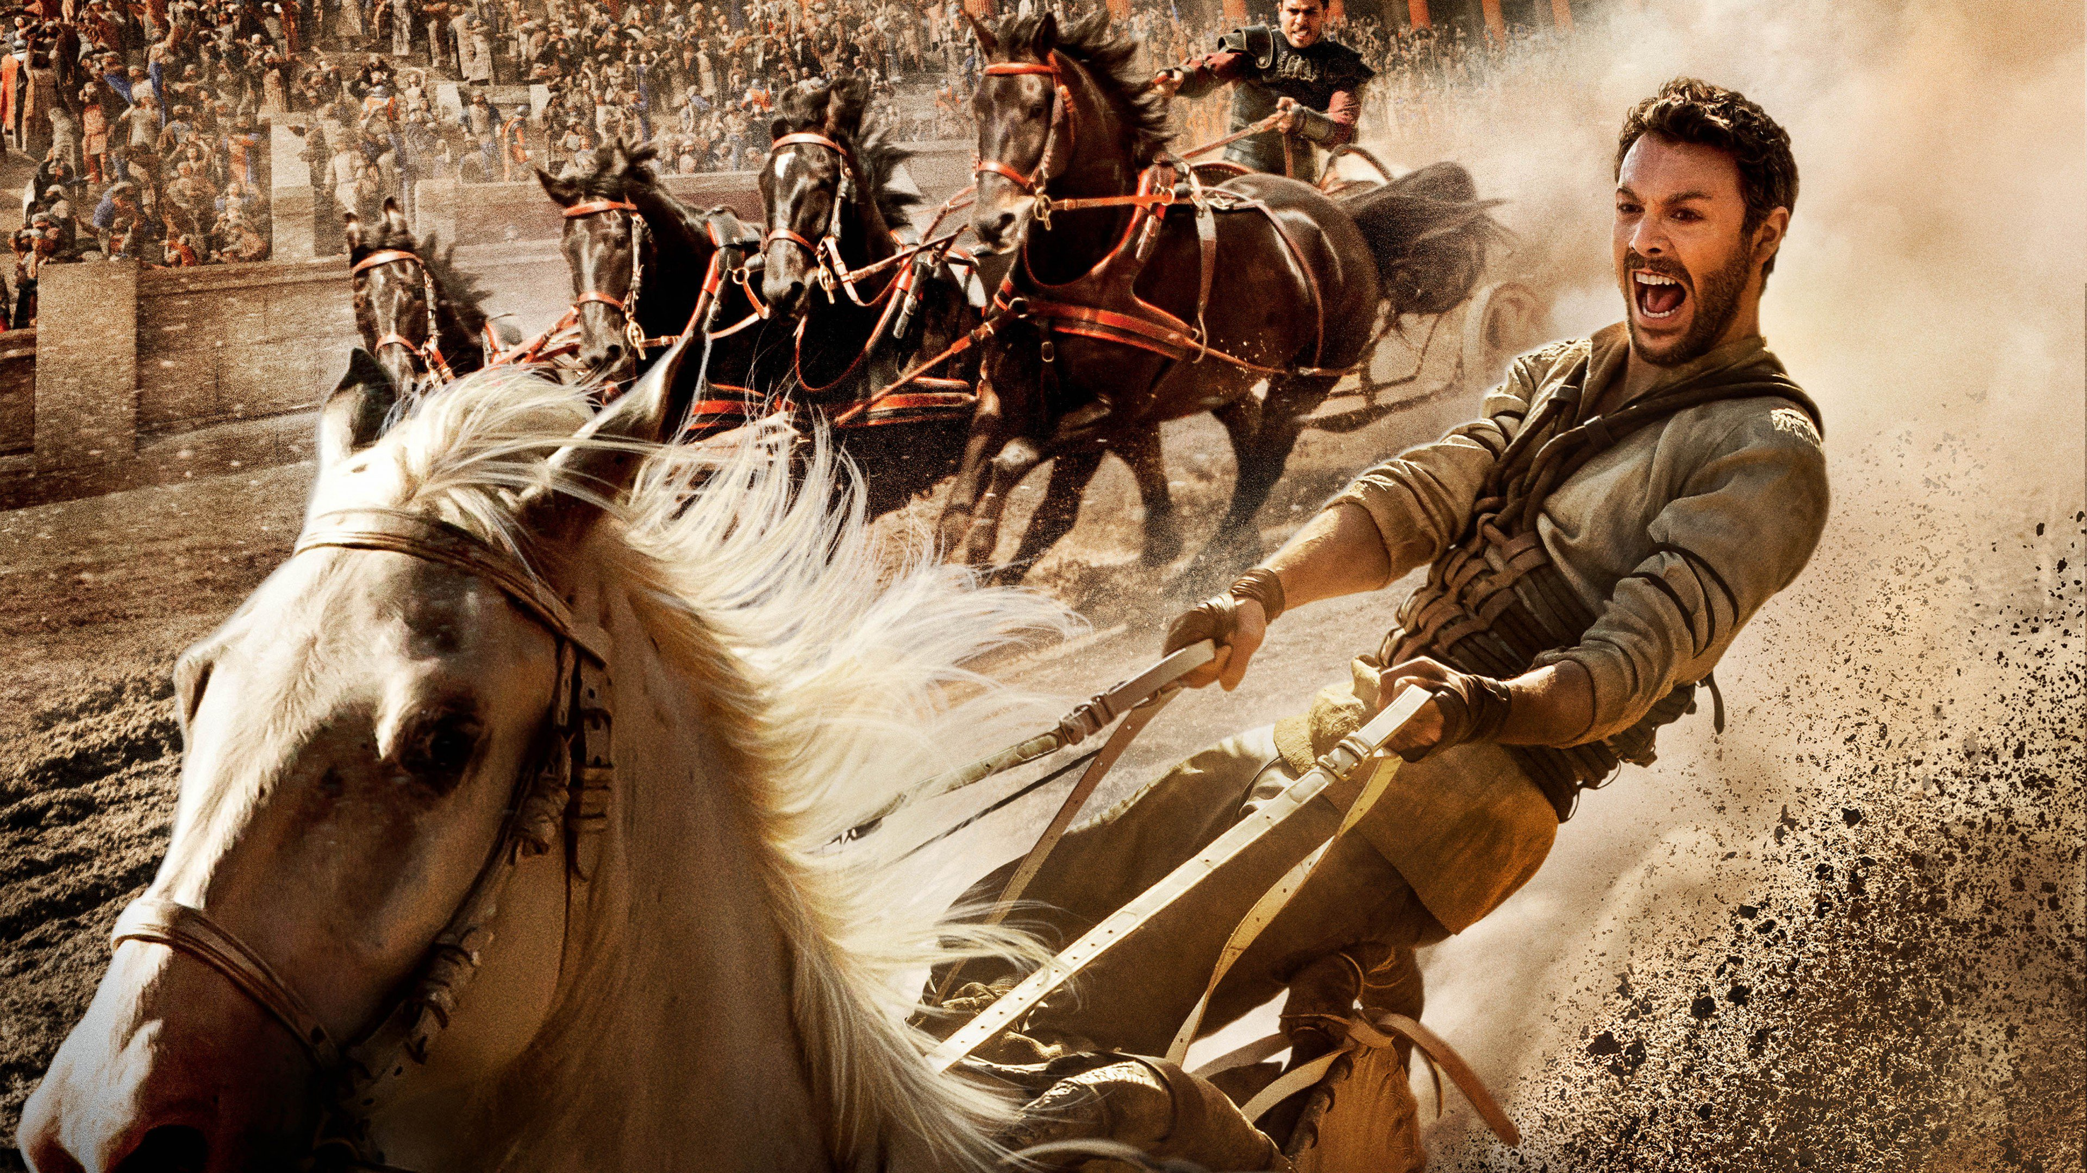
EL ANIMO DE HUR
Ex 17:8-16

Slide 2
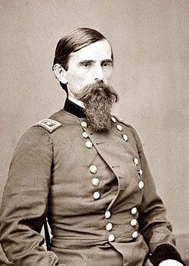
Imagen Inventada
La imagen de portada de este sermón es de la película Ben-Hur de 2017.
Este fue un remake del mismo título de 1959 con Charlton Hesston
Este fue un remake de la misma película de 1925
Esto fue extraído del Libro de Lew Wallace-1880
Este libro ha sido calificado como el libro más influyente del siglo XIX.
El libro y el personaje de Ben Hur son ficticios.
Pero la Biblia habla de quién deriva el nombre.

Slide 3
Notes:
Exodus 17:8-16 KJV Then came Amalek, and fought with Israel in Rephidim. (9) And Moses said unto Joshua, Choose us out men, and go out, fight with Amalek: to morrow I will stand on the top of the hill with the rod of God in mine hand. (10) So Joshua did as Moses had said to him, and fought with Amalek: and Moses, Aaron, and Hur went up to the top of the hill. (11) And it came to pass, when Moses held up his hand, that Israel prevailed: and when he let down his hand, Amalek prevailed. (12) But Moses' hands were heavy; and they took a stone, and put it under him, and he sat thereon; and Aaron and Hur stayed up his hands, the one on the one side, and the other on the other side; and his hands were steady until the going down of the sun. (13) And Joshua discomfited Amalek and his people with the edge of the sword. (14) And the LORD said unto Moses, Write this for a memorial in a book, and rehearse it in the ears of Joshua: for I will utterly put out the remembrance of Amalek from under heaven. (15) And Moses built an altar, and called the name of it Jehovahnissi: (16) For he said, Because the LORD hath sworn that the LORD will have war with Amalek from generation to generation.

Slide 4
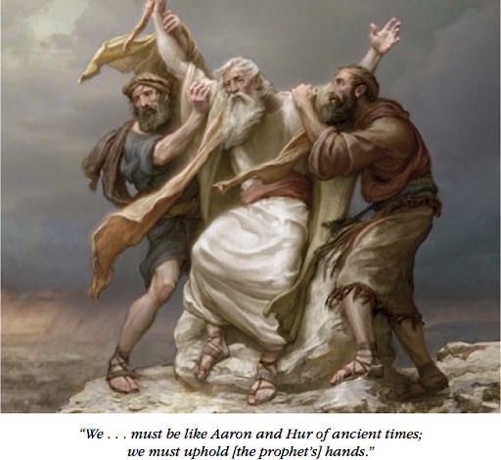
Nosotros tenemos el deber de ayudar
Romanos 16: 1-2 Os recomiendo a Febe nuestra hermana, que es una sierva de la iglesia que está en Cencrea: (2) que la recibáis en el Señor, digna de los santos, y que la ayudéis en todo lo que sea. puede que tenga necesidad de ti, porque ella misma también ha ayudado a muchos y a mí mismo.
Romanos 16: 9 Saludad a Urbano, nuestro ayudador en Cristo, y a Staquis compañero mío.

Slide 5
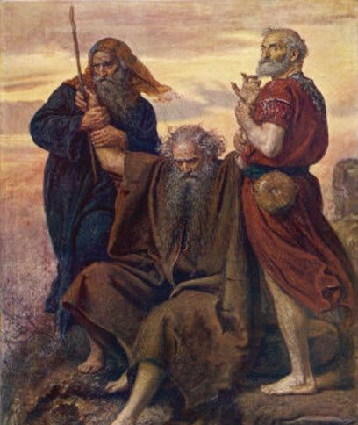
Nosotros tenemos el deber de alentar
Hebreos 12: 12-15
1 Tesalonicenses 3: 2-5
1 Tesalonicenses 4: 13-18
1 Tesalonicenses 5: 10-11; 14
Romanos 12: 5-8
2 Corintios 13:11
Notes:
Hebrews 12:12-15 KJV Wherefore lift up the hands which hang down, and the feeble knees; (13) And make straight paths for your feet, lest that which is lame be turned out of the way; but let it rather be healed. (14) Follow peace with all men, and holiness, without which no man shall see the Lord: (15) Looking diligently lest any man fail of the grace of God; lest any root of bitterness springing up trouble you, and thereby many be defiled;
1 Thessalonians 3:2-5 NIV (2) We sent Timothy, who is our brother and co-worker in God's service in spreading the gospel of Christ, to strengthen and encourage you in your faith, (3) so that no one would be unsettled by these trials. For you know quite well that we are destined for them. (4) In fact, when we were with you, we kept telling you that we would be persecuted. And it turned out that way, as you well know. (5) For this reason, when I could stand it no longer, I sent to find out about your faith. I was afraid that in some way the tempter had tempted you and that our labors might have been in vain.
1 Thessalonians 4:13-18 NIV (13) Brothers and sisters, we do not want you to be uninformed about those who sleep in death, so that you do not grieve like the rest of mankind, who have no hope. (14) For we believe that Jesus died and rose again, and so we believe that God will bring with Jesus those who have fallen asleep in him. (15) According to the Lord's word, we tell you that we who are still alive, who are left until the coming of the Lord, will certainly not precede those who have fallen asleep. (16) For the Lord himself will come down from heaven, with a loud command, with the voice of the archangel and with the trumpet call of God, and the dead in Christ will rise first. (17) After that, we who are still alive and are left will be caught up together with them in the clouds to meet the Lord in the air. And so we will be with the Lord forever. (18) Therefore encourage one another with these words.
1 Thessalonians 5:10-11 NIV (10) He died for us so that, whether we are awake or asleep, we may live together with him. (11) Therefore encourage one another and build each other up, just as in fact you are doing.
1 Thessalonians 5:14 NIV (14) And we urge you, brothers and sisters, warn those who are idle and disruptive, encourage the disheartened, help the weak, be patient with everyone.
Romans 12:5-8 NIV so in Christ we, though many, form one body, and each member belongs to all the others. (6) We have different gifts, according to the grace given to each of us. If your gift is prophesying, then prophesy in accordance with your faith; (7) if it is serving, then serve; if it is teaching, then teach; (8) if it is to encourage, then give encouragement; if it is giving, then give generously; if it is to lead, do it diligently; if it is to show mercy, do it cheerfully.
2 Corinthians 13:11 NIV (11) Finally, brothers and sisters, rejoice! Strive for full restoration, encourage one another, be of one mind, live in peace. And the God of love and peace will be with you.

Slide 6
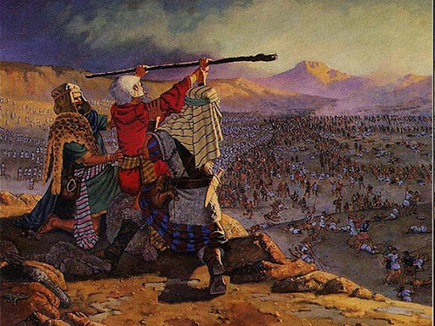
Cada uno tiene que hacer su parte
Efesios 4:16 De él, todo el cuerpo, unido y sostenido por cada ligamento de apoyo, crece y se fortalece en el amor, ya que cada parte hace su trabajo.
Notes:
Ephesians 4:14-16 NIV Then we will no longer be infants, tossed back and forth by the waves, and blown here and there by every wind of teaching and by the cunning and craftiness of people in their deceitful scheming. (15) Instead, speaking the truth in love, we will grow to become in every respect the mature body of him who is the head, that is, Christ. (16) From him the whole body, joined and held together by every supporting ligament, grows and builds itself up in love, as each part does its work.
Ephesians 2:19-22 NIV Consequently, you are no longer foreigners and strangers, but fellow citizens with God's people and also members of his household, (20) built on the foundation of the apostles and prophets, with Christ Jesus himself as the chief cornerstone. (21) In him the whole building is joined together and rises to become a holy temple in the Lord. (22) And in him you too are being built together to become a dwelling in which God lives by his Spirit.
Colossians 2:18-19 NIV Do not let anyone who delights in false humility and the worship of angels disqualify you. Such a person also goes into great detail about what they have seen; they are puffed up with idle notions by their unspiritual mind. (19) They have lost connection with the head, from whom the whole body, supported and held together by its ligaments and sinews, grows as God causes it to grow.

Slide 7
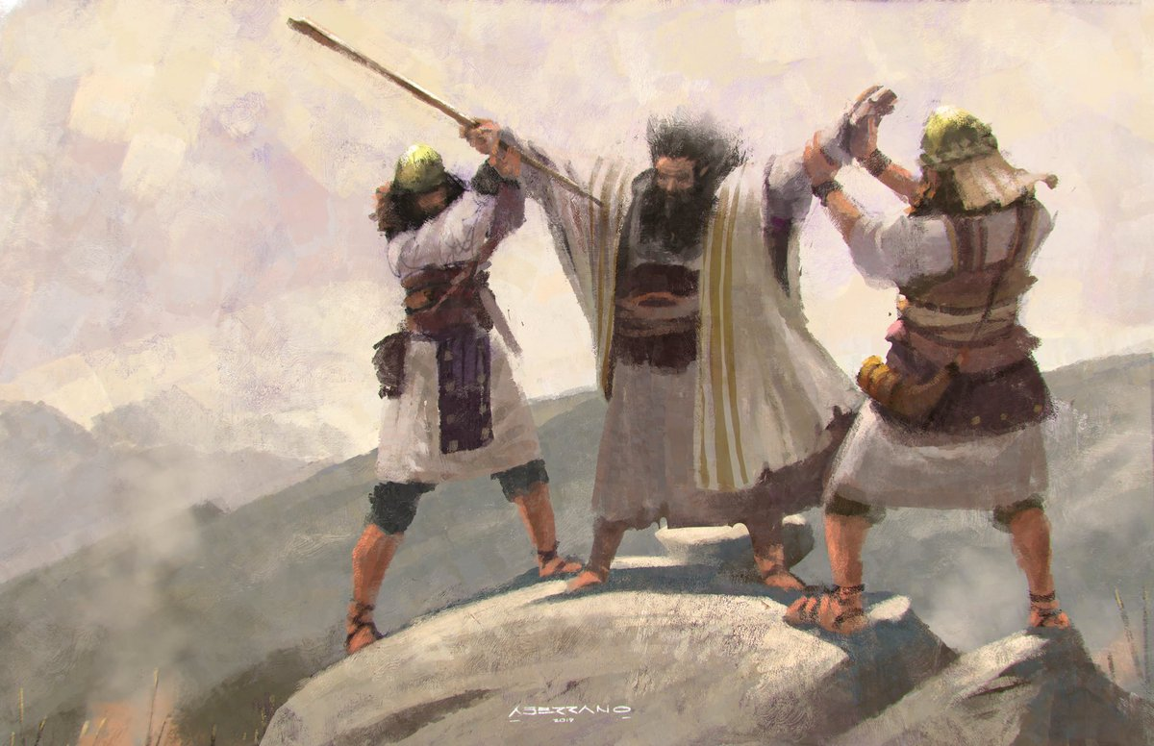
Estimularse unos a otros
Hebreos 10: 24-25 Y consideremos cómo podemos animarnos los unos a los otros al amor y a las buenas obras, (25) sin dejar de reunirnos, como algunos tienen por costumbre, sino animarnos unos a otros, y todos los más a medida que ve que se acerca el día.

Slide 8
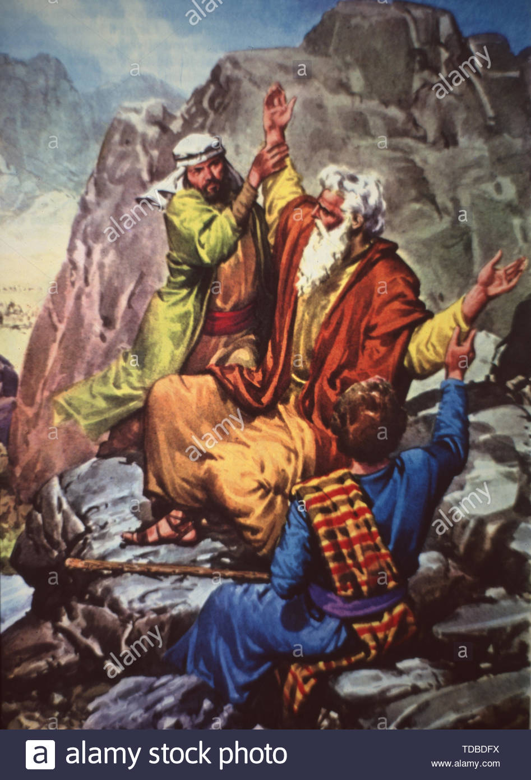
Las pequeñas cosas que puedes hacer
Las pequeñas cosas que puedes hacer
Versículo 1: Hay lugar en el reino de Dios, hermano mío, Para las pequeñas cosas que puedes hacer; Solo una pequeña acción amable que puede alegrar a otro es la obra que Dios ha planeado para ti.
Verso 2: Sólo un vaso de agua fría en Su nombre dado Que la esperanza en algún corazón se renueve; No espere a que le digan, ni el dolor lo lleve a la obra que Dios ha planeado para usted.
Versículo 3: Hay un lugar en el servicio de Dios para los obreros que le son fieles y leales; ¿No puedes decirle ahora: "Dejaré a los vagabundos y haré el trabajo que has planeado".
Estribillo: Tú eres lugar, hay un lugar en el reino de Dios para ti; Hay espacio, hay un lugar, hay trabajo que todos podemos hacer.

